Slide 1
Clustering, Classification and Regression

Slide 2
Machine Learning
Machine learning (ML) is an essential skill for any aspiring data analyst and data scientist, and also for those who wish to transform a massive amount of raw data into trends and predictions.
ML is the application of computer algorithms that improve automatically through experience. ML algorithms build a model based on sample data, known as “training data”, in order to make predictions or decisions without being explicitly programmed to do so.

Slide 3
Machine Learning is broadly classified into Supervised, Unsupervised, and Semi-supervised.
Regression and Classification comes under Supervised learning (answer for all the feature points are mapped) and clustering comes under unsupervised learning (answer will not be given for the points).

Slide 4
Regression - If the prediction value tends to be a continuous value then it falls under Regression type problem in machine learning
Example : Giving area name, size of land, etc as features and predicting expected cost of the land.
Classification - If the prediction value tends to be category like yes/no , positive/negative , etc then it falls under classification type problem in machine learning
Example : Given a sentence predicting whether it is negative or positive review

Slide 5
Clustering - Grouping a set of points to given number of clusters. Clustering is the classification of objects into different groups, or more precisely, the partitioning of a data set into subsets (clusters), so that the data in each subset (ideally) share some common trait - often according to some defined distance measure.
Example : Given 3, 4, 8, 9 and number of clusters to be 2 then the ML system might divide the given set into cluster 1 - 3, 4 and cluster 2 - 8, 9

Slide 6
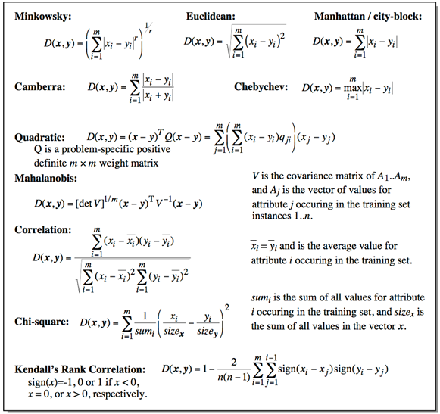
Common Distance measures:

Slide 7
AGGLOMERATIVE CLUSTERING

Slide 8
Agglomerative Clustering
Initialization:
Each object is a cluster
Iteration:
Merge two clusters which are
most similar to each other;
Until all objects are merged
into a single cluster
a
a b
b
a b c d e
c
c d e
d
d e
e
Step 0
Step 1
Step 2
Step 3
Step 4
bottom-up

Slide 9
Dendrogram
A binary tree that shows how clusters are merged/split hierarchically
Each node on the tree is a cluster; each leaf node is a singleton cluster

Slide 10
Dendrogram
A clustering of the data objects is obtained by cutting the dendrogram at the desired level, then each connected component forms a cluster

Slide 11
Dendrogram
A clustering of the data objects is obtained by cutting the dendrogram at the desired level, then each connected component forms a cluster

Slide 12
How to Merge Clusters?
How to measure the distance between clusters?
Single-link
Complete-link
Average-link
Centroid distance
Distance?
Hint: Distance between clusters is usually defined on the basis of distance between objects.

Slide 13
How to Define Inter-Cluster Distance
Single-link
Complete-link
Average-link
Centroid distance
The distance between two clusters is represented by the distance of the closest pair of data objects belonging to different clusters.

Slide 14
How to Define Inter-Cluster Distance
Single-link
Complete-link
Average-link
Centroid distance
The distance between two clusters is represented by the distance of the farthest pair of data objects belonging to different clusters.

Slide 15
How to Define Inter-Cluster Distance
Single-link
Complete-link
Average-link
Centroid distance
The distance between two clusters is represented by the average distance of all pairs of data objects belonging to different clusters.

Slide 16
How to Define Inter-Cluster Distance
×
×
m_{i},m_{j} are the means of C_{i}, C_{j}.
Single-link
Complete-link
Average-link
Centroid distance
The distance between two clusters is represented by the distance between the means of the cluters.

Slide 17
An Example of the Agglomerative Clustering Algorithm
For the following data set, we will get different clustering results with the single-link and complete-link algorithms.
1
5
3
4
2
6

Slide 18
Result of the Single-Link algorithm:
1
5
3
4
2
6
1
3
4
5
2
6
Result of the Complete-Link algorithm:
1
5
3
4
2
6
1
3
2
4
5
6

Slide 19
Hierarchical Clustering: Comparison
Single-link
Complete-link
5
1
4
1
3
2
5
5
5
2
1
2
2
3
6
3
3
6
1
4
4
4
Average-link
Centroid distance
5
1
5
4
2
1
5
2
2
5
2
3
6
3
3
6
4
1
1
4
4
3

Slide 20
Compare Dendrograms
Single-link
Complete-link
1 2 5 3 6 4
1 2 5 3 6 4
Average-link
Centroid distance
1 2 5 3 6 4
2 5 3 6 4 1

Slide 21
Which Distance Measure is Better?
Each method has both advantages and disadvantages; application-dependent, single-link and complete-link are the most common methods
Single-link
Can find irregular-shaped clusters
Sensitive to outliers, suffers the so-called chaining effects
Complete-link, Average-link, and Centroid distance
Robust to outliers
Tend to break large clusters
Prefer spherical clusters

Slide 22
Single Linkage

Slide 23
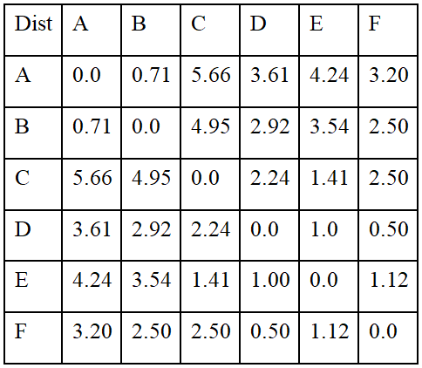
Question: Consider an input distance matrix of size 6 by 6. This distance matrix was calculated based on the object features.
In the beginning, there are six clusters namely, A, B, C, D, E and F. Form a single cluster, which consists of these six objects at the end of the iterations using single linkage algorithm. Draw the dendogram.

Slide 24
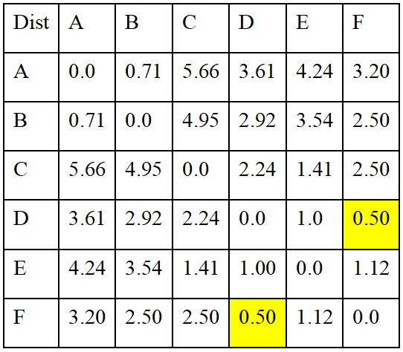
Answer: In the first iteration, consider each data point as a single cluster and find the nearest pair of clusters.
Here, D and F are the nearest clusters. Hence, D and F are grouped into a single cluster, (D, F).

Slide 25
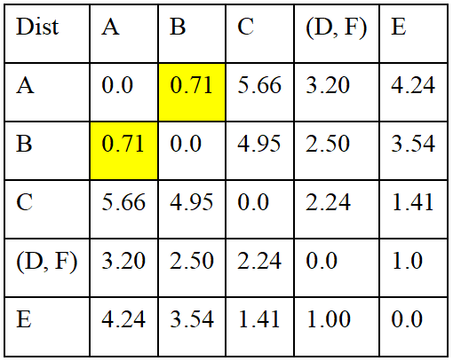
In the second iteration, first obtain a new data matrix by removing the clusters D & F and including the cluster (D, F). Various distances corresponding to the new cluster (D, F) are computed as follows:
d_{(D, F)->A}= d_{A->(D, F)} =min(d_{DA},d_{FA})=min(3.61, 3.20)=3.20
d_{(D, F)->B}= d_{B->(D, F)} =min(d_{DB},d_{FB})=min(2.92, 2.50)=2.50
d_{(D, F)->C}= d_{c->(D, F)} =min(d_{DC},d_{FC})=min(2.24, 2.50)=2,24
d_{(D, F)->E}= d_{E->(D, F)} =min(d_{DE},d_{FE})=min(1.0, 1.12)=1.0
Here, A and B are the nearest clusters. Hence, A and B are grouped into a single cluster, (A, B).

Slide 26
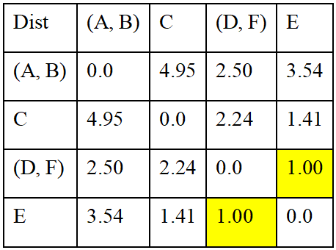
In the third iteration, first obtain a new data matrix by removing the clusters A & B and including the cluster (A, B). Various distances corresponding to the new cluster (A, B) are computed as follows:
d_{(A, B)->C}= d_{C->(A, B)} =min(d_{AC},d_{BC})=min(5.66, 4.95)=4.95
d_{(A, B)->E}= d_{E->(A, B)} =min(d_{AE},d_{BE})=min(4.24, 3.54)=3.54
d_{(A, B)->(D, F)}= d_{(D, F)->(A, B)} = min(d_{(D, F)->A}, d_{(D, F)->B}) =min(d_{DA},d_{DB,}d_{FA},d_{FB})=min(3.61, 2.92, 3.20, 2.50)=2.50.
Here, (D, F) and E are the nearest clusters. Hence, (D, F) and E are grouped into a single cluster, ((D, F), E).

Slide 27
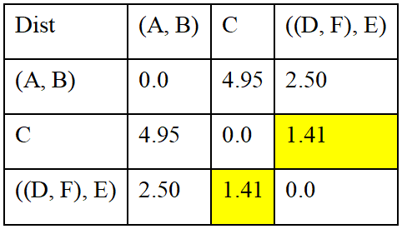
In the fourth iteration, first obtain a new data matrix by removing the clusters (D, F) & E and including the cluster ((D, F), E). Various distances corresponding to the new cluster ((D, F), E) are computed as follows:
d_{((D, F), E)->(A, B)}= d_{(A, B)->((D, F), E)}=min(d_{(D, F)->(A, B)}, d_{E->(A, B)}) =min(d_{DA},d_{DB,}d_{FA},d_{FB}, d_{EA},d_{EB})=min(3.61, 2.92, 3.20, 2.50, 4.24, 3.54)=2.50.
d_{((D, F), E)->C}= d_{C->((D, F), E)}=min(d_{(D, F)->C}, d_{EC})= min(d_{DC},d_{FC},d_{EC}) =min(2.24,2.50,1.41)=1.41.
Here, ((D, F), E) and C are the nearest clusters. Hence, ((D, F), E) and C are grouped into a single cluster, (((D, F), E), C).

Slide 28
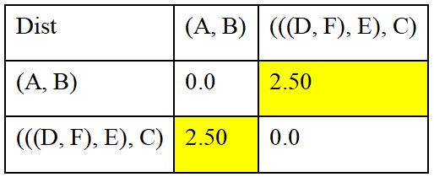
In the fifth iteration, first obtain a new data matrix by removing the clusters ((D, F), E) & C and including the cluster (((D, F), E), C). Various distances corresponding to the new cluster (((D, F), E), C) are computed as follows:
d_{(((D, F), E),C)->(A, B)}= d_{(A, B)->(((D, F), E),C)}=min(d_{((D, F), E)->(A, B)}, d_{C->(A, B)})= min(d_{(D, F)->(A, B)}, d_{E->(A, B),} d_{CA}, d_{CB})=min(d_{(D, F)->A}, d_{(D, F)->B},d_{EA},d_{EB,} d_{CA}, d_{CB})= min(d_{DA},d_{FA}, d_{DB,}d_{FB},d_{EA},d_{EB,}d_{CA},d_{CB})=min(3.61,3.20,2.92,2.50,4.24,3.54,5.66,4.95)=2.50.
Here, (((D, F), E), C) and (A, B) are the nearest clusters. Hence, finally the clusters (((D, F), E), C) and (A, B) are grouped into a single cluster, ((((D, F), E), C), (A, B)). Now all the data points are grouped into a single cluster, hence the process of single linkage clustering stops.

Slide 29
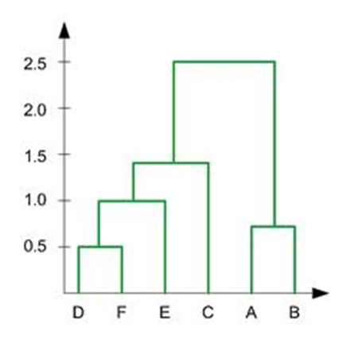
The Dendrogram of the above single linkage clustering process, which represents how the data points/clusters are evantually merged to form a single cluster is shown below:

Slide 30
Complete Linkage

Slide 31
Question: Consider an input distance matrix of size 6 by 6. This distance matrix was calculated based on the object features.
In the beginning, there are six clusters namely, A, B, C, D, E and F. Form a single cluster, which consists of these six objects at the end of the iterations using complete linkage algorithm. Draw the dendogram.

Slide 32
Answer: In the first iteration, consider each data point as a single cluster and find the nearest pair of clusters.
Here, D and E are the nearest clusters. Hence, D and F are grouped into a single cluster, (D, E).

Slide 33

In the second iteration, first obtain a new data matrix by removing the clusters D & E and including the cluster (D, E). Various distances corresponding to the new cluster (D, E) are computed as follows:
d_{(D, F)->A}= d_{A->(D, F)} =max(d_{DA},d_{FA})=max(3.61, 3.20)=3.61
d_{(D, F)->B}= d_{B->(D, F)} =max(d_{DB},d_{FB})=max(2.92, 2.50)=2.92
d_{(D, F)->C}= d_{c->(D, F)} =max(d_{DC},d_{FC})=max(2.24, 2.50)=2,50
d_{(D, F)->E}= d_{E->(D, F)} =max(d_{DE},d_{FE})=max(1.0, 1.12)=1.12
Here, A and B are the nearest clusters. Hence, A and B are grouped into a single cluster, (A, B).

Slide 34
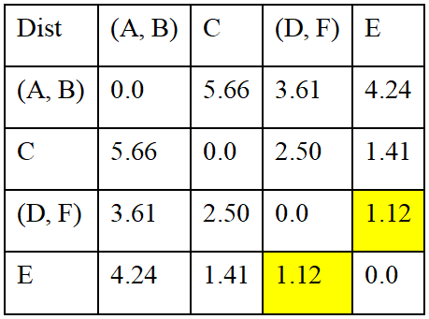
In the third iteration, first obtain a new data matrix by removing the clusters A & B and including the cluster (A, B). Various distances corresponding to the new cluster (A, B) are computed as follows:
d_{(A, B)->C}= d_{C->(A, B)} =max(d_{AC},d_{BC})=max(5.66, 4.95)=5.66
d_{(A, B)->E}= d_{E->(A, B)} =max(d_{AE},d_{BE})=max(4.24, 3.54)=4.24
d_{(A, B)->(D, F)}= d_{(D, F)->(A, B)} = max(d_{(D, F)->A}, d_{(D, F)->B}) =max(d_{DA},d_{DB,}d_{FA},d_{FB})=max(3.61, 2.92, 3.20, 2.50)=361.
Here, (D, F) and E are the nearest clusters. Hence, (D, F) and E are grouped into a single cluster, ((D, F), E).

Slide 35
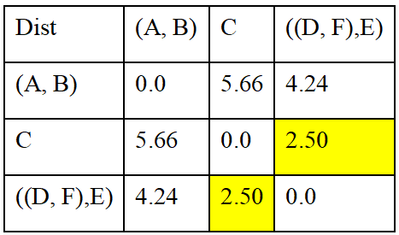
In the fourth iteration, first obtain a new data matrix by removing the clusters (D, F) & E and including the cluster ((D, F), E). Various distances corresponding to the new cluster ((D, F), E) are computed as follows:
d_{((D, F), E)->(A, B)}= d_{(A, B)->((D, F), E)}= max(d_{(D, F)->(A, B)}, d_{E->(A, B)}) =max(d_{DA},d_{DB,}d_{FA},d_{FB}, d_{EA},d_{EB})=max(3.61,2.92,3.20,2.50,4.24,3.54)=4.24.
d_{((D, F), E)->C}= d_{C->((D, F), E)}=max(d_{(D, F)->C}, d_{EC})=max(d_{DC},d_{FC},d_{EC}) =max(2.24,2.50,1.41)=2.50.
Here, ((D, F), E) and C are the nearest clusters. Hence, ((D, F), E) and C are grouped into a single cluster, (((D, F), E), C).

Slide 36
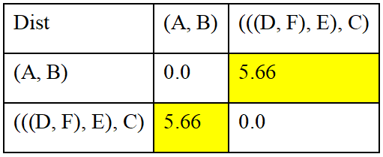
In the fifth iteration, first obtain a new data matrix by removing the clusters ((D, F), E) & C and including the cluster (((D, F), E), C). Various distances corresponding to the new cluster (((D, F), E), C) are computed as follows:
d_{(((D, F), E),C)->(A, B)}= d_{(A, B)->(((D, F), E),C)}= max(d_{((D, F), E)->(A, B)}, d_{C->(A, B)})= max(d_{(D, F)->(A, B)}, d_{E->(A, B),} d_{CA}, d_{CB})=max(d_{(D, F)->A}, d_{(D, F)->B},d_{EA},d_{EB,} d_{CA}, d_{CB})=max(d_{DA},d_{FA}, d_{DB,}d_{FB},d_{EA},d_{EB,}d_{CA},d_{CB})=max(3.61,3.20,2.92,2.50,4.24,3.54,5.66,4.95)=5.66.
Here, (((D, F), E), C) and (A, B) are the nearest clusters. Hence, finally the clusters (((D, F), E), C) and (A, B) are grouped into a single cluster, ((((D, F), E), C), (A, B)). Now all the data points are grouped into a single cluster, hence the process of complete linkage clustering stops.

Slide 37
The Dendrogram of the above complete linkage clustering process, which represents how the data points/clusters are evantually merged to form a single cluster is shown below:

Slide 38
Average Linkage

Slide 39
Question: Consider an input distance matrix of size 6 by 6. This distance matrix was calculated based on the object features.
In the beginning, there are six clusters namely, A, B, C, D, E and F. Form a single cluster, which consists of these six objects at the end of the iterations using average linkage algorithm. Draw the dendogram.

Slide 40
Answer: In the first iteration, consider each data point as a single cluster and find the nearest pair of clusters.
Here, D and E are the nearest clusters. Hence, D and F are grouped into a single cluster, (D, E).

Slide 41
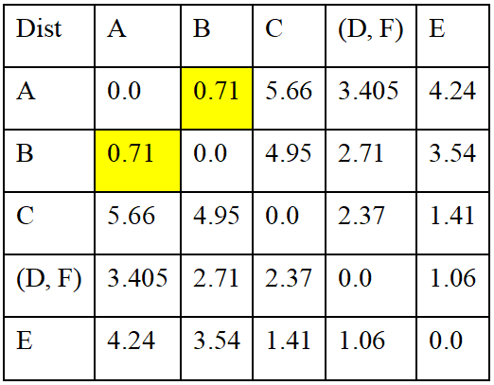
In the second iteration, first obtain a new data matrix by removing the clusters D & E and including the cluster (D, E). Various distances corresponding to the new cluster (D, E) are computed as follows:
d_{(D, F)->A}= d_{A->(D, F)} =(d_{DA}+d_{FA})/2=(3.61+3.20)/2=3.405
d_{(D, F)->B}= d_{B->(D, F)} =(d_{DB}+d_{FB})/2=(2.92+2.50)/2=2.71
d_{(D, F)->C}= d_{c->(D, F)} =(d_{DC},d_{FC})/2=(2.24+2.50)/2=2.37
d_{(D, F)->E}= d_{E->(D, F)} =(d_{DE}+d_{FE})/2=(1.0+1.12)/2=1.06
Here, A and B are the nearest clusters. Hence, A and B are grouped into a single cluster, (A, B).

Slide 42
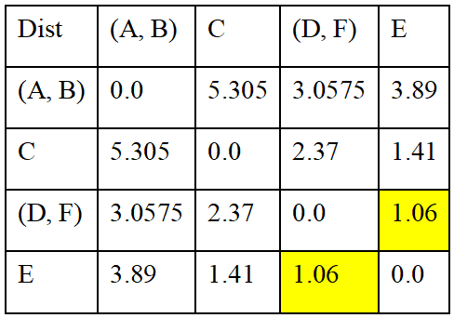
In the third iteration, first obtain a new data matrix by removing the clusters A & B and including the cluster (A, B). Various distances corresponding to the new cluster (A, B) are computed as follows:
d_{(A, B)->C}= d_{C->(A, B)} =(d_{AC}+d_{BC})/2=(5.66+4.95)/2=5.305
d_{(A, B)->E}= d_{E->(A, B)} =(d_{AE}+d_{BE})/2=(4.24+3.54)/2=3.89
d_{(A, B)->(D, F)}= d_{(D, F)->(A, B)} = mean(d_{(D, F)->A}, d_{(D, F)->B}) =(d_{DA}+d_{DB}+d_{FA}+d_{FB})/4=(3.61+2.92+3.20+2.50)/4= 3.0575
Here, (D, F) and E are the nearest clusters. Hence, (D, F) and E are grouped into a single cluster, ((D, F), E).

Slide 43
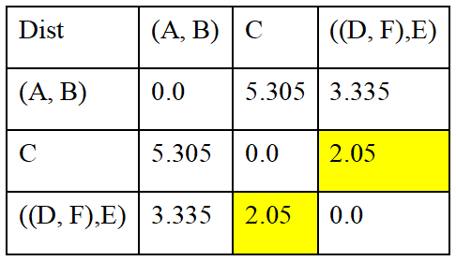
In the fourth iteration, first obtain a new data matrix by removing the clusters (D, F) & E and including the cluster ((D, F), E). Various distances corresponding to the new cluster ((D, F), E) are computed as follows:
d_{((D, F), E)->(A, B)}= d_{(A, B)->((D, F), E)}=mean(d_{(D, F)->(A, B)}, d_{E->(A, B)}) =(d_{DA}+d_{DB}+d_{FA}+d_{FB}+d_{EA}+d_{EB})/6=(3.61+2.92+3.20+2.50+4.24+3.54)/6=3.335.
d_{((D, F), E)->C}= d_{C->((D, F), E)}=mean(d_{(D, F)->C}, d_{EC}) =(d_{DC}+d_{FC}+d_{EC})/3=(2.24+2.50+1.41)/3=2.05.
Here, ((D, F), E) and C are the nearest clusters. Hence, ((D, F), E) and C are grouped into a single cluster, (((D, F), E), C).

Slide 44
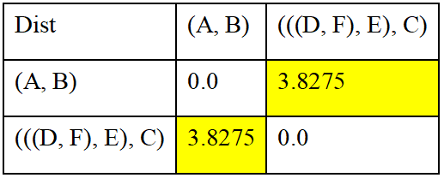
In the fifth iteration, first obtain a new data matrix by removing the clusters ((D, F), E) & C and including the cluster (((D, F), E), C). Various distances corresponding to the new cluster (((D, F), E), C) are computed as follows:
d_{(((D, F), E),C)->(A, B)}= d_{(A, B)->(((D, F), E),C)}=mean(d_{((D, F), E)->(A, B)}, d_{C->(A, B)})
=mean(d_{(D, F)->(A, B)}, d_{E->(A, B),} d_{CA}, d_{CB})=mean(d_{(D, F)->A}, d_{(D, F)->B},d_{EA},d_{EB,} d_{CA}, d_{CB}) =(d_{DA}+d_{FA}+d_{DB}+d_{FB}+d_{EA}+d_{EB}+d_{CA}+d_{CB})/8 =(3.61+3.20+2.92+2.50+4.24+3.54+5.66+4.95)/8=3.8275.
Here, (((D, F), E), C) and (A, B) are the nearest clusters. Hence, finally the clusters (((D, F), E), C) and (A, B) are grouped into a single cluster, ((((D, F), E), C), (A, B)). Now all the data points are grouped into a single cluster, hence the process of average linkage clustering stops.

Slide 45
The Dendrogram of the above average linkage clustering process, which represents how the data points/clusters are evantually merged to form a single cluster is shown below:

Slide 46
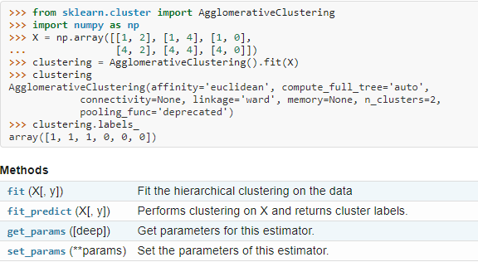
Sample python code for agglomerative clustering obtained from scikit-learn.org:
Here, linkage selects the type of agglomerative clustering:
linkage : {“ward”, “complete”, “average”, “single”}, optional (default=”ward”)

Slide 47
K-MEANS CLUSTERING

Slide 48
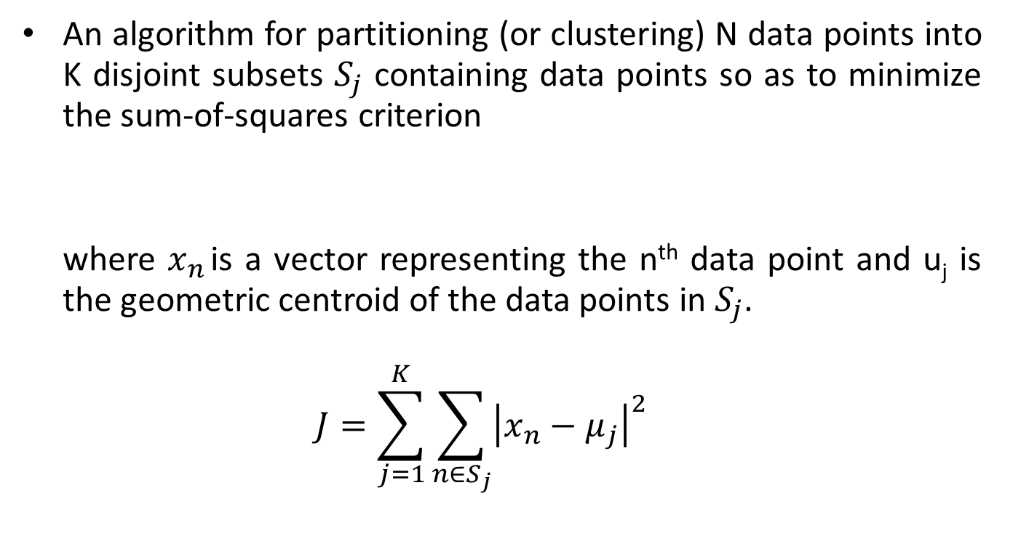
K-means clustering

Slide 49
Simply speaking k-means clustering is an algorithm to classify or to group the objects based on attributes/features into K number of group.
K is positive integer number.
The grouping is done by minimizing the sum of squares of distances between data and the corresponding cluster centroid.

Slide 50
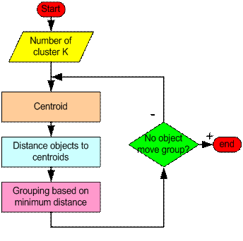
How the K-Mean Clustering algorithm works?

Slide 51
Step 1: Begin with a decision on the value of k= number of clusters.
Step 2: Put any initial partition that classifies the data into k clusters. You may assign the training samples randomly, or systematically as the following:
Take the first k training sample as single-element clusters.
Assign each of the remaining (N-k) training sample to the cluster with the nearest centroid. After each assignment, recomputed the centroid of the gaining cluster.

Slide 52
Step 3: Take each sample in sequence and compute its distance from the centroid of each of the clusters. If a sample is not currently in the cluster with the closest centroid, switch this sample to that cluster and update the centroid of the cluster gaining the new sample and the cluster losing the sample.
Step 4: Repeat step 3 until convergence is achieved, that is until a pass through the training sample causes no new assignments.

Slide 53
A Simple example showing the implementation of k-means algorithm (using K=2)

Slide 54
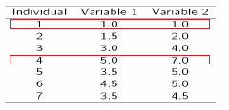
Step 1:
Initialization: Randomly we choose following two centroids (k=2) for two clusters.
In this case the 2 centroid are: m1=(1.0,1.0) and m2=(5.0,7.0).

Slide 55



Step 2:
Thus, we obtain two clusters containing:
{1,2,3} and {4,5,6,7}.
Their new centroids are:

Slide 56
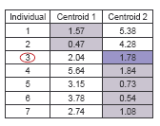
Step 3:
Now using these centroids we compute the Euclidean distance of each object, as shown in table.
Therefore, the new clusters are:
{1,2} and {3,4,5,6,7}
Next centroids are: m1=(1.25,1.5) and m2 = (3.9,5.1)

Slide 57
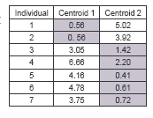
Step 4 :
The clusters obtained are:
{1,2} and {3,4,5,6,7}
Therefore, there is no change in the cluster.
Thus, the algorithm comes to a halt here and final result consist of 2 clusters {1,2} and {3,4,5,6,7}.

Slide 58
PLOT

Slide 59
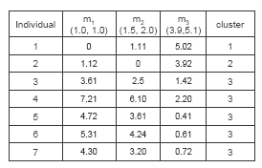
(with K=3)
Step 1
Step 2

Slide 60
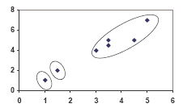
PLOT

Slide 61
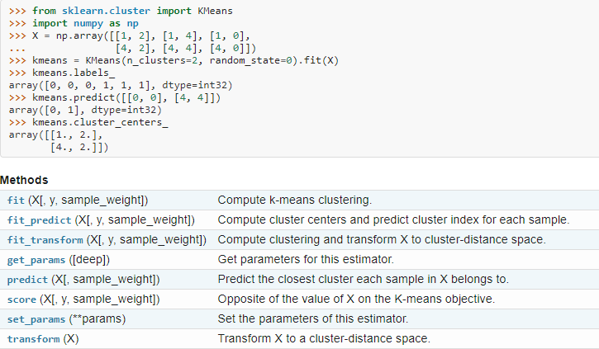
Sample python code for k-means clustering obtained from scikit-learn.org:

Slide 62
K NEAREST NEIGHBOUR CLASSIFIER

Slide 63
Instance-based learning is often termed lazy learning, as there is typically no “transformation” of training instances into more general “statements”
Instead, the presented training data is simply stored and, when a new query instance is encountered, a set of similar, related instances is retrieved from memory and used to classify the new query instance
Hence, instance-based learners never form an explicit general hypothesis regarding the target function. They simply compute the classification of each new query instance as needed

Slide 64
K Nearest Neighbour
1. The simplest, most used instance-based learning algorithm is the k-NN algorithm
2. k-NN assumes that all instances are points in some n-dimensional space and defines neighbors in terms of distance (usually Euclidean in R-space)
3. k is the number of neighbors considered
4. Determine parameter K = number of nearest neighbours
5. Calculate the distance between the query-instance and all the training samples
6. Sort the distance and determine nearest neighbours based on the K-th minimum distance
7. Gather the category of the nearest neighbours
8. Use simple majority of the category of nearest neighbours as the prediction value of the query instance

Slide 65
Basic Idea
Using the second property, the k-NN classification rule is to assign to a test sample the majority category label of its k nearest training samples
In practice, k is usually chosen to be odd, so as to avoid ties
The k = 1 rule is generally called the nearest-neighbor classification rule

Slide 66
Scale Effects
Different features may have different measurement scales
E.g., patient weight in kg (range [50,200]) vs. blood protein values in ng/dL (range [-3,3])
Consequences
Patient weight will have a much greater influence on the distance between samples
May bias the performance of the classifier

Slide 67
Standardization
Transform raw feature values into z-scores
is the value for the i^{th} sample and j^{th} feature
is the average of all for feature j
is the standard deviation of all over all input samples
Range and scale of z-scores should be similar (providing distributions of raw feature values are alike)

Slide 68
Training data
Test instance
Notes:
OK here is the data.
Now let’s calculate the distance between this example and all the others.
Do on the overhead projector using pen.
So distance between 8 and 7 is
SQRT ( 0 + 1 + 25 + 1) = SQRT(27)= 5.2
THINK a moment. DOES this seem sensible to you?
Isn’t the calculation being skewed by the large values of the rectangle data relative to the other data?

Slide 69
Normalised training data
Test instance

Slide 70
Distances of test instance from training data
Classification
1-NN Yes
3-NN Yes
5-NN No
7-NN No
Notes:
Here are the distances
Before clicking to reveal classification table
So what would a 1-nearest neighbour classifier predict for the test instance?
What would a 3-nearest neighbour predict?

Slide 71
We have data from the questionnaires survey (to ask people opinion) and objective testing with two attributes (acid durability and strength) to classify whether a special paper tissue is good or not. Here is four training samples
X1 = Acid Durability (seconds) | X2 = Strength (kg/square meter) | Y = Classification
7 | 7 | Bad
7 | 4 | Bad
3 | 4 | Good
1 | 4 | good
Now the factory produces a new paper tissue that pass laboratory test with X1 = 3 and X2 = 7. Without another expensive survey, can we guess what the classification of this new tissue is?

Slide 72
Determine parameter K = number of nearest neighbours, Suppose use K = 3
Calculate the distance between the query-instance and all the training samples
Coordinate of query instance is (3, 7), instead of calculating the distance we compute square distance which is faster to calculate (without square root).
X1 = Acid Durability (seconds) | X2 = Strength (kg/square meter) | Square Distance to query instance (3, 7)
7 | 7 | 16
7 | 4 | 25
3 | 4 | 9
1 | 4 | 13

Slide 73
Sort the distance and determine nearest neighbours based on k-th minimum distance
X1 = Acid Durability (seconds) | X2 = Strength (kg/square meter) | Square Distance to query instance (3, 7) | Rank minimum distance | Is it included in 3-Nearest neighbors?
7 | 7 | 16 | 3 | Yes
7 | 4 | 25 | 4 | No
3 | 4 | 9 | 1 | Yes
1 | 4 | 13 | 2 | Yes

Slide 74
Gather the category of the nearest neighbours. Notice in the second row last column
that the category of nearest neighbour (Y) is not included because the rank of this data is more than 3 (=K).
X1 = Acid Durability (seconds) | X2 = Strength (kg/square meter) | Square Distance to query instance (3, 7) | Rank minimum distance | Is it included in 3-Nearest neighbours? | Y = Category of nearest Neighbour
7 | 7 | 16 | 3 | Yes | Bad
7 | 4 | 25 | 4 | No | -
3 | 4 | 9 | 1 | Yes | Good
1 | 4 | 13 | 2 | Yes | Good

Slide 75
Use simple majority of the category of nearest neighbors as the prediction value of the query instance
We have 2 good and 1 bad, since 2>1 then we conclude that a new paper tissue that pass
laboratory test with X1 = 3 and X2 = 7 is included in Good category .

Slide 76
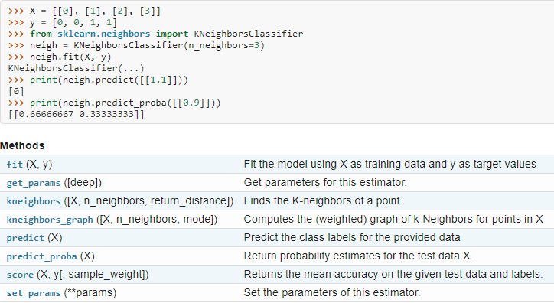
Sample python code for k-nearest neighbor classifier obtained from scikit-learn.org:

Slide 77
MINIMUM SPANNING TREE CLASSIFIER

Slide 78
Minimum Spanning Tree Classifier
Minimum Spanning tree based classifier uses a minimum spanning tree, constructed from the given data to classify various entities.
After obtaining the minimum spanning tree, specific number of most weighted edges are deleted from it to get a particular number of clusters accordingly.
In order to obtain ‘n’ clusters, remove ‘n-1’ large weighted edges from the minimum spanning tree.

Slide 79
Spanning Trees
A spanning tree of a graph is just a subgraph that contains all the vertices and is a tree.
A graph may have many spanning trees.
Graph A
Some Spanning Trees from Graph A
or
or
or

Slide 80
Complete Graph
All 16 of its Spanning Trees

Slide 81
Minimum Spanning Trees
The Minimum Spanning Tree for a given graph is the Spanning Tree of minimum cost for that graph.
Complete Graph
Minimum Spanning Tree
7
2
2
5
3
3
4
1
1

Slide 82
Algorithms for Obtaining the Minimum Spanning Tree
Kruskal's Algorithm
Prim's Algorithm
Boruvka's Algorithm

Slide 83
Kruskal's Algorithm
This algorithm creates a forest of trees. Initially the forest consists of n single node trees (and no edges). At each step, we add one edge (the cheapest one) so that it joins two trees together. If it were to form a cycle, it would simply link two nodes that were already part of a single connected tree, so that this edge would not be needed.

Slide 84
The steps of Krushkal’s algorithm are:
1. The forest is constructed - with each node in a separate tree.
2. The edges are placed in a priority queue.
3. Until we've added n-1 edges,
1. Extract the cheapest edge from the queue,
2. If it forms a cycle, reject it,
3. Else add it to the forest. Adding it to the forest will join two trees together.
Every step will have joined two trees in the forest together, so that at the end, there will only be one tree in T.

Slide 85
Complete Graph
B
4
C
4
2
1
A
4
E
1
F
D
2
3
10
G
5
5
6
3
4
I
H
2
3
J

Slide 86
A
4
B
A
1
D
B
4
C
B
4
D
B
4
C
B
10
J
C
2
E
4
2
1
C
1
F
D
5
H
A
4
E
1
F
2
D
6
J
E
2
G
D
3
10
G
5
F
3
G
F
5
I
5
6
3
4
I
G
3
I
G
4
J
H
2
3
J
H
2
J
I
3
J

Slide 87
Sort Edges
(in reality they are placed in a priority queue - not sorted - but sorting them makes the algorithm easier to visualize)
A
1
D
C
1
F
C
2
E
E
2
G
B
4
C
H
2
J
F
3
G
4
2
1
G
3
I
I
3
J
A
4
E
1
F
2
A
4
B
B
4
D
D
3
10
G
5
B
4
C
G
4
J
5
6
3
4
I
F
5
I
D
5
H
H
2
3
J
D
6
J
B
10
J

Slide 88
A
1
D
C
1
F
Add Edge
C
2
E
E
2
G
B
4
C
H
2
J
F
3
G
4
2
1
G
3
I
I
3
J
A
4
E
1
F
2
A
4
B
B
4
D
D
3
10
G
5
B
4
C
G
4
J
5
6
3
4
I
F
5
I
D
5
H
H
2
3
J
D
6
J
B
10
J

Slide 89
A
1
D
C
1
F
Add Edge
C
2
E
E
2
G
B
4
C
H
2
J
F
3
G
4
2
1
G
3
I
I
3
J
A
4
E
1
F
2
A
4
B
B
4
D
D
3
10
G
5
B
4
C
G
4
J
5
6
3
4
I
F
5
I
D
5
H
H
2
3
J
D
6
J
B
10
J

Slide 90
A
1
D
C
1
F
Add Edge
C
2
E
E
2
G
B
4
C
H
2
J
F
3
G
4
2
1
G
3
I
I
3
J
A
4
E
1
F
2
A
4
B
B
4
D
D
3
10
G
5
B
4
C
G
4
J
5
6
3
4
I
F
5
I
D
5
H
H
2
3
J
D
6
J
B
10
J

Slide 91
A
1
D
C
1
F
Add Edge
C
2
E
E
2
G
B
4
C
H
2
J
F
3
G
4
2
1
G
3
I
I
3
J
A
4
E
1
F
2
A
4
B
B
4
D
D
3
10
G
5
B
4
C
G
4
J
5
6
3
4
I
F
5
I
D
5
H
H
2
3
J
D
6
J
B
10
J

Slide 92
A
1
D
C
1
F
Add Edge
C
2
E
E
2
G
B
4
C
H
2
J
F
3
G
4
2
1
G
3
I
I
3
J
A
4
E
1
F
2
A
4
B
B
4
D
D
3
10
G
5
B
4
C
G
4
J
5
6
3
4
I
F
5
I
D
5
H
H
2
3
J
D
6
J
B
10
J

Slide 93
Cycle,
Don’t Add Edge
A
1
D
C
1
F
C
2
E
E
2
G
B
4
C
H
2
J
F
3
G
4
2
1
G
3
I
I
3
J
A
4
E
1
F
2
A
4
B
B
4
D
D
3
10
G
5
B
4
C
G
4
J
5
6
3
4
I
F
5
I
D
5
H
H
2
3
J
D
6
J
B
10
J

Slide 94
A
1
D
C
1
F
Add Edge
C
2
E
E
2
G
B
4
C
H
2
J
F
3
G
4
2
1
G
3
I
I
3
J
A
4
E
1
F
2
A
4
B
B
4
D
D
3
10
G
5
B
4
C
G
4
J
5
6
3
4
I
F
5
I
D
5
H
H
2
3
J
D
6
J
B
10
J

Slide 95
A
1
D
C
1
F
Add Edge
C
2
E
E
2
G
B
4
C
H
2
J
F
3
G
4
2
1
G
3
I
I
3
J
A
4
E
1
F
2
A
4
B
B
4
D
D
3
10
G
5
B
4
C
G
4
J
5
6
3
4
I
F
5
I
D
5
H
H
2
3
J
D
6
J
B
10
J

Slide 96
A
1
D
C
1
F
Add Edge
C
2
E
E
2
G
B
4
C
H
2
J
F
3
G
4
2
1
G
3
I
I
3
J
A
4
E
1
F
2
A
4
B
B
4
D
D
3
10
G
5
B
4
C
G
4
J
5
6
3
4
I
F
5
I
D
5
H
H
2
3
J
D
6
J
B
10
J

Slide 97
Cycle,
Don’t Add Edge
A
1
D
C
1
F
C
2
E
E
2
G
B
4
C
H
2
J
F
3
G
4
2
1
G
3
I
I
3
J
A
4
E
1
F
2
A
4
B
B
4
D
D
3
10
G
5
B
4
C
G
4
J
5
6
3
4
I
F
5
I
D
5
H
H
2
3
J
D
6
J
B
10
J

Slide 98
A
1
D
C
1
F
Add Edge
C
2
E
E
2
G
B
4
C
H
2
J
F
3
G
4
2
1
G
3
I
I
3
J
A
4
E
1
F
2
A
4
B
B
4
D
D
3
10
G
5
B
4
C
G
4
J
5
6
3
4
I
F
5
I
D
5
H
H
2
3
J
D
6
J
B
10
J

Slide 99
Minimum Spanning Tree
Complete Graph
B
4
C
4
B
C
4
4
2
1
2
1
A
E
A
4
1
F
E
F
1
D
2
2
D
3
10
G
G
5
3
5
6
3
4
I
I
H
H
2
3
3
J
2
J

Slide 100
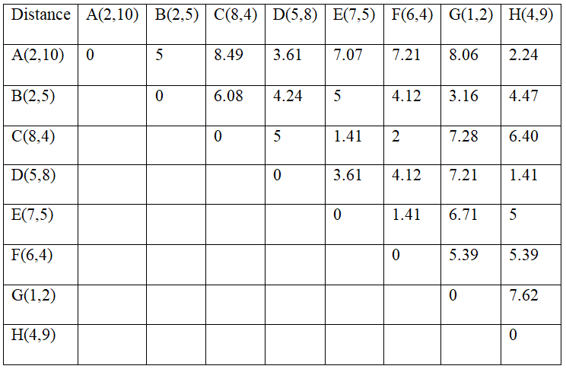
Question: Use the Spanning tree based classifier to cluster the following 8 examples into ‘n’ clusters such that 0<n<9: A1=(2,10), A2=(2,5), A3=(8,4), A4=(5,8), A5=(7,5), A6=(6,4), A7=(1,2), A8=(4,9).
Answer: First compute the distance matrix for the given data, which is shown below:

Slide 101
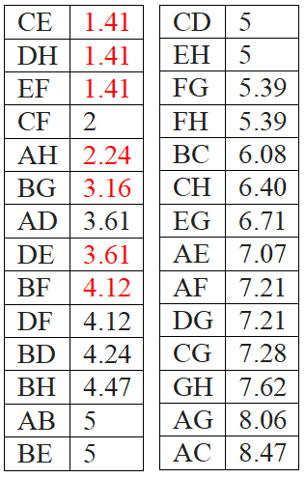
Arrange the edges in non-decreasing order, which is shown below:
Inorder to find the minimum spanning tree, consider the edges starting from the least weight and include edges until all the points are added with no cycle. Here, Kruskal’s algorithm is used. Edges corresponds to the distances mark in red are selected for the minimum spanning tree.

Slide 102
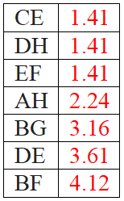
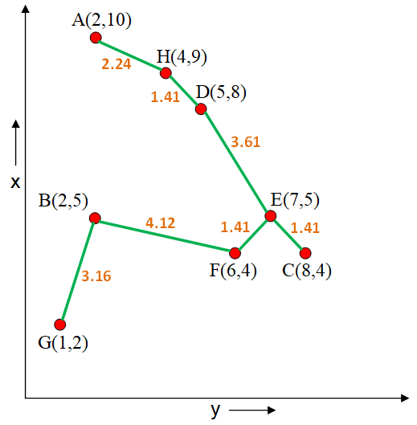
The minimum spanning tree for the given data is as follows:
The minimum spanning tree for the given data can be interpreted as a single cluster (n=1) containing all the data points.

Slide 103
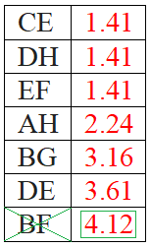
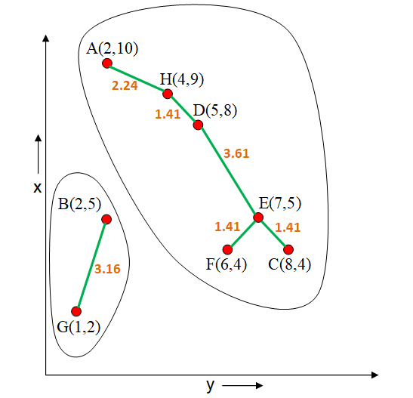
For n=2, i.e. To cluster the given data into two clusters, remove the edge from the minimum spanning tree which has maximum weight. In this case, BF is to be removed from the spanning tree. The two clusters are shown below:

Slide 104
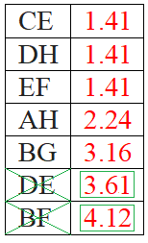
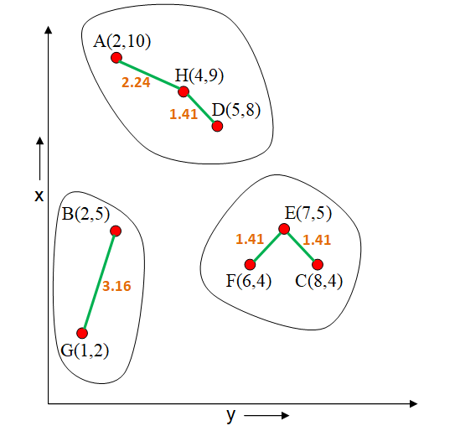
For n=3, i.e. To cluster the given data into three clusters, remove the two most weighted edges from the minimum spanning tree. In this case, BF and DE are to be removed from the spanning tree. The three clusters are shown below:

Slide 105
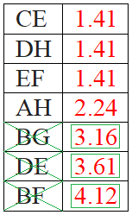
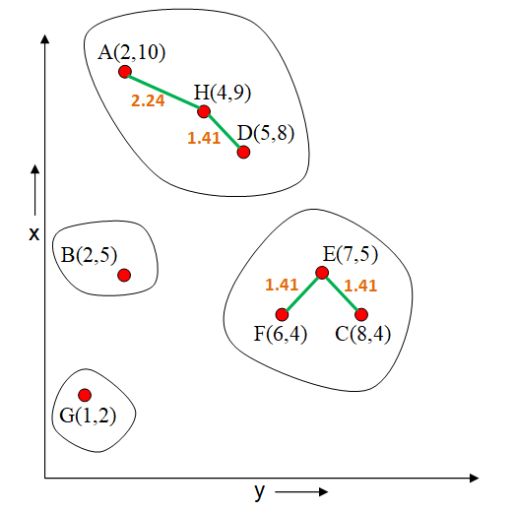
For n=4, i.e. To cluster the given data into four clusters, remove the three most weighted edges from the minimum spanning tree. In this case, BF, DE and BG are to be removed from the spanning tree. The four clusters are shown below:

Slide 106
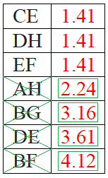
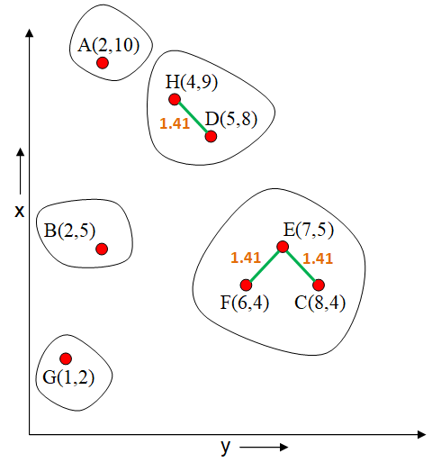
For n=5, i.e. To cluster the given data into five clusters, remove the four most weighted edges from the minimum spanning tree. In this case, BF, DE, BG and AH are to be removed from the spanning tree. The five clusters are shown below:

Slide 107
Similarly, for obtaining ‘n’ clusters, ‘n-1’ most weighted edges are deleted from the minimum spanning tree. Edges are randomly selected when more than one edge have same weight. For the above example, for ‘n=6’, five edges i.e. along with BF, DE, BG and AH any one from CE, DH and EF is deleted from the minimum spanning tree.

Slide 108
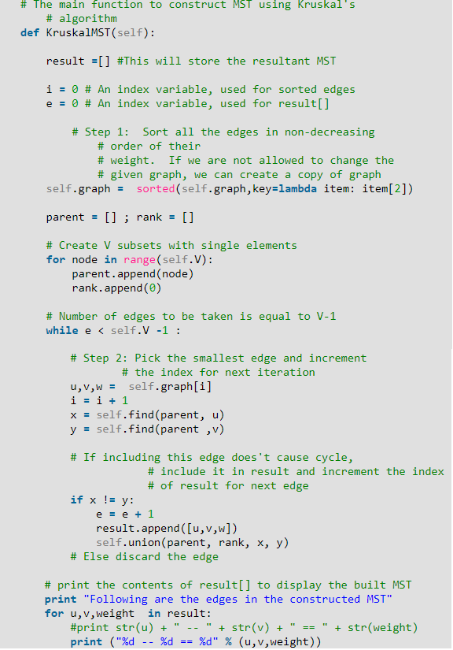
Sample python code for finding minimum spanning tree using Kruskal’s algorithm classifier obtained from geeksforgeeks.org :

Slide 109
THE BAYES CLASSIFIER

Slide 110
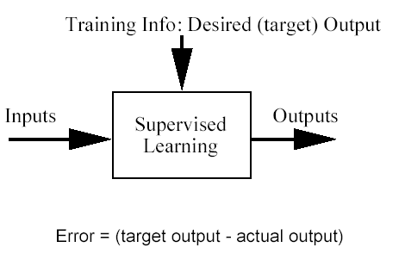
Classification problem
Training data: examples of the form (d,h(d))
where d are the data objects to classify (inputs)
and h(d) are the correct class info for d, h(d)∈{1,…K}
Goal: given d_{new}, provide h(d_{new})

Slide 111
A word about the Bayesian framework
Allows us to combine observed data and prior knowledge
Provides practical learning algorithms
It is a generative (model based) approach, which offers a useful conceptual framework
This means that any kind of objects (e.g. time series, trees, etc.) can be classified, based on a probabilistic model specification

Slide 112

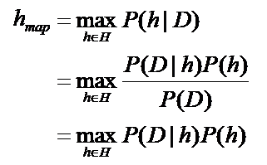
Bayes’ Rule
P(h) = prior probability of hypothesis h
P(D) = prior probability of training data D
P(h|D) = probability of h given D (posterior density )
P(D|h) = probability of D given h (likelihood of D given h)
The Goal of Bayesian Learning: the most probable hypothesis given the training data (Maximum A Posteriori hypothesis )

Slide 113
Probabilities – auxiliary slide for memory refreshing
Have two dice h₁ and h₂
The probability of rolling an i given die h₁ is denoted P(i|h₁). This is a conditional probability
Pick a die at random with probability P(h_{j}), j=1 or 2. The probability for picking die h_{j} and rolling an i with it is called joint probability and is P(i, h_{j})=P(h_{j})P(i| h_{j}).
For any events X and Y, P(X,Y)=P(X|Y)P(Y)
If we know P(X,Y), then the so-called marginal probability P(X) can be computed as
Probabilities sum to 1. Conditional probabilities sum to 1 provided that their conditions are the same.

Slide 114
Does patient have cancer or not?
A patient takes a lab test and the result comes back positive. It is known that the test returns a correct positive result in only 98% of the cases and a correct negative result in only 97% of the cases. Furthermore, only 0.008 of the entire population has this disease.
1. What is the probability that this patient has cancer?
2. What is the probability that he does not have cancer?
3. What is the diagnosis?

Slide 115
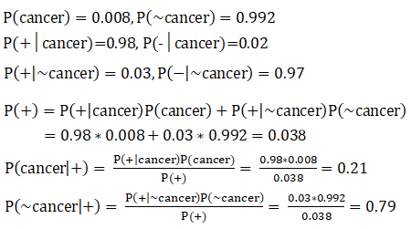

Slide 116
Choosing Hypotheses
Maximum Likelihood hypothesis:
Generally we want the most probable hypothesis given training data. This is the maximum a posteriori hypothesis:
Useful observation: it does not depend on the denominator P(d)

Slide 117


Now we compute the diagnosis
To find the Maximum Likelihood hypothesis, we evaluate P(d|h) for the data d, which is the positive lab test and chose the hypothesis (diagnosis) that maximises it:
To find the Maximum A Posteriori hypothesis, we evaluate P(d|h)P(h) for the data d, which is the positive lab test and chose the hypothesis (diagnosis) that maximises it. This is the same as choosing the hypotheses gives the higher posterior probability.

Slide 118
The Naïve Bayes Classifier
What can we do if our data d has several attributes?
Naïve Bayes assumption: Attributes that describe data instances are conditionally independent given the classification hypothesis
it is a simplifying assumption, obviously it may be violated in reality
in spite of that, it works well in practice
The Bayesian classifier that uses the Naïve Bayes assumption and computes the MAP hypothesis is called Naïve Bayes classifier
One of the most practical learning methods
Successful applications:
Medical Diagnosis
Text classification

Slide 119
Naïve Bayes solution
Classify any new datum instance x=(a₁,…a_{T}) as:
To do this based on training examples, we need to estimate the parameters from the training examples:
For each target value (hypothesis) h
For each attribute value a_{t} of each datum instance

Slide 120
Example. ‘Play Tennis’ data
Notes:
120

Slide 121
Play-tennis example: estimating P(x_{i}|C)
outlook
P(sunny|p) = 2/9 | P(sunny|n) = 3/5
P(overcast|p) = 4/9 | P(overcast|n) = 0
P(rain|p) = 3/9 | P(rain|n) = 2/5
temperature
P(hot|p) = 2/9 | P(hot|n) = 2/5
P(mild|p) = 4/9 | P(mild|n) = 2/5
P(cool|p) = 3/9 | P(cool|n) = 1/5
humidity
P(high|p) = 3/9 | P(high|n) = 4/5
P(normal|p) = 6/9 | P(normal|n) = 2/5
windy
P(true|p) = 3/9 | P(true|n) = 3/5
P(false|p) = 6/9 | P(false|n) = 2/5
P(p) = 9/14
P(n) = 5/14

Slide 122
Given a training set, we can compute the probabilities

Slide 123
Based on the examples in the table, classify the following datum x:
x=(Outl=Sunny, Temp=Cool, Hum=High, Wind=strong)
That means: Play tennis or not?
Working:

